Slide 1
Psychology: From Inquiry to Understanding
Fourth Edition
Chapter 16
Psychological and Biological Treatments
HELPING PEOPLE CHANGE

Slide 2
Lecture Preview
Psychotherapy
Insight Therapies
Group Therapies
Behavioral and Cognitive-Behavioral Approaches
Is Psychotherapy Effective?
Biomedical Treatments

Slide 3
16.1: Psychotherapy: Clients and Practitioners
16.1a Describe who seeks treatment, who benefits from psychotherapy, and who practices psychotherapy.
16.1b Describe what it takes to be an effective therapist.

Slide 4
Psychotherapy LO 16.1a Describe who seeks treatment, who benefits from psychotherapy, and who practices psychotherapy.
A psychological intervention designed to help people resolve emotional, behavioral, and interpersonal problems and improve the quality of their lives
Over 500 “brands” of psychotherapy
Notes:
LO 16.1

Slide 5
Who Seeks and Benefits? LO 16.1a Describe who seeks treatment, who benefits from psychotherapy, and who practices psychotherapy.
20 percent of Americans have received psychotherapy at some point in their lives.
Females go more than males; Caucasians more than minority groups.
However, research shows that therapy can benefit all these groups equally.
Notes:
LO 16.1

Slide 6
Who Practices Psychotherapy? (1 of 3) LO 16.1a Describe who seeks treatment, who benefits from psychotherapy, and who practices psychotherapy.
Clinical psychologists, psychiatrists, counselors, and social workers are the mainstays of the mental health profession.
But people with nonadvanced degrees also often offer psychological services.
Social services agencies, crisis intervention centers
Notes:
LO 16.1

Slide 7
Who Practices Psychotherapy? (3 of 3) LO 16.1b Distinguish between professionals and paraprofessionals and describe what it takes to be an effective therapist.
Effective therapists
Warm and direct
Establish a positive working relationship
Tend not to contradict clients
Select important topics to focus on in session
Match treatments to needs of clients
Notes:
LO 16.2

Slide 8
16.2: Insight Therapies: Acquiring Understanding
16.2a Describe the core beliefs and criticisms of psychodynamic therapies.
16.2b Describe and evaluate the effectiveness of humanistic therapies.

Slide 9
Insight Therapies LO 16.2a Describe the core beliefs and criticisms of psychodynamic therapies.
Psychotherapies where the goal is to expand awareness or insight
Include psychodynamic and humanistic therapies
Notes:
LO 16.3

Slide 10
Psychoanalytic and Psychodynamic Therapies (1 of 4) LO 16.2a Describe the core beliefs and criticisms of psychodynamic therapies.
Believe that abnormal behaviors stem from adverse childhood experiences
Analyze avoided thoughts and feelings, wishes and fantasies, significant past events, and the therapeutic relationship
Believe that symptoms will vanish when clients gain insight into unconscious material
Notes:
LO 16.3

Slide 11
Psychoanalytic and Psychodynamic Therapies (2 of 4) LO 16.2a Describe the core beliefs and criticisms of psychodynamic therapies.
Psychoanalysis
Developed by Freud; one of the first forms of therapy
Goal is to decrease guilt and frustration and make the unconscious conscious.
Tries to bring to awareness previously repressed impulses, conflicts, and memories
Six core techniques:
Free association
Interpretation
Dream analysis
Resistance
Transference
Working through
Notes:
LO 16.3

Slide 12
Psychoanalytic and Psychodynamic Therapies (4 of 4) LO 16.2a Describe the core beliefs and criticisms of psychodynamic therapies.
Psychodynamic therapies evaluated scientifically
Research, however, shows that insight is not necessary to relieve distress.
In addition, many psychodynamic concepts are difficult to falsify.
Research shows no evidence for repressing hurtful memories either.
Psychodynamic therapies are scientifically questionable.
Still, brief psychodynamic therapy is better than no treatment, but is less effective than cognitive-behavioral therapy.
Not effective for psychotic disorders
Notes:
LO 16.3

Slide 13
Humanistic Therapies (1 of 4) LO 16.2b Describe and evaluate the effectiveness of humanistic therapies.
Therapies that emphasize
Development of human potential
Belief that human nature is basically positive
Emphasize importance of taking responsibility for our lives and living in the present
Notes:
LO 16.4

Slide 14
Humanistic Therapies (2 of 4) LO 16.2b Describe and evaluate the effectiveness of humanistic therapies.
Person-centered therapy
Developed by Carl Rogers
Nondirective—encourages clients to direct the course of their therapy
To ensure positive outcome, therapist must
Be authentic and genuine
Express unconditional positive regard
Show emphatic understanding
Tries to increase awareness and heightened self-acceptance
This ideally causes people to
Think more realistically
Become more tolerant of others
Engage in more adaptive behaviors
Notes:
LO 16.4

Slide 15
Humanistic Therapies (4 of 4) LO 16.2b Describe and evaluate the effectiveness of humanistic therapies.
Humanistic therapies evaluated scientifically
Core concepts are difficult to falsify.
But, its conditions for effective therapists have been found to be related to outcome.
More effective than no treatment, but mixed results compared to other therapies
Notes:
LO 16.4

Slide 16
16.3: Group Therapies: The More the Merrier
16.3a List the advantages of group methods.
16.3b Describe the research evidence concerning the effectiveness of Alcoholics Anonymous.
16.3c Identify different approaches to treating the dysfunctional family system.

Slide 17
Group Therapies LO 16.3a List the advantages of group methods.
Refers to therapies that treat more than one person at a time
Range from 3 to 20 people; can be efficient, time-saving, and less costly than individual
Effective for a wide range of problems and about as helpful as individual treatments
Notes:
LO 16.5

Slide 18
Alcoholics Anonymous LO 16.3b Describe the research evidence concerning the effectiveness of Alcoholics Anonymous.
Self-help groups like AA have become very popular and widespread.
Composed of peers with similar problems; often no professional therapists
Based on “12 Steps” method, but little research demonstrating its effectiveness
Notes:
LO 16.6

Slide 19
Family Therapies (1 of 2) LO 16.3c Identify different approaches to treating the dysfunctional family system.
See most psychological problems as rooted in a dysfunctional family system
The “patient” is the whole family system, not one individual.
Focus on interactions among family members
Notes:
LO 16.7

Slide 20
16.4: Behavioral and Cognitive-Behavioral Approaches: Changing Maladaptive Actions and Thoughts
16.4a Describe the characteristics of behavior therapy and identify different behavioral approaches.
16.4b Describe the features of cognitive-behavioral therapies (CBT) and third-wave therapies.

Slide 21
Behavioral and Cognitive-Behavioral Approaches LO 16.4a Describe the characteristics of behavior therapy and identify different behavioral approaches.
Behavior therapists focus on specific problem behaviors and the variables that maintain them.
Assume that behavior change results from the application of basic principles of learning
Use a wide variety of behavioral assessment techniques
Notes:
LO 16.8

Slide 22
Systematic Desensitization and Exposure Therapies (1 of 2) LO 16.4a Describe the characteristics of behavior therapy and identify different behavioral approaches.
Confront clients with what they fear with the goal of reducing the fear
Earliest was systematic desensitization, developed by Joseph Wolpe in 1958.
SD gradually exposes clients to anxiety-producing situations through the use of imagined scenes.
Notes:
LO 16.8

Slide 23
Systematic Desensitization and Exposure Therapies (2 of 2) LO 16.4a Describe the characteristics of behavior therapy and identify different behavioral approaches.
Systematic desensitization
Based on principle of reciprocal inhibition—we can’t be anxious and relaxed at the same time.
Uses counterconditioning by repeatedly pairing an incompatible relaxation response with anxiety
Can use imaginal and in vivo exposure to the fear situations listed on the created hierarchy
Dismantling research showed that no single component was essential.
Led to development of exposure with response prevention therapies like flooding
Very effective for many anxiety disorders, like phobias, OCD, and PTSD
Notes:
LO 16.8

Slide 24
Modeling in Therapy LO 16.4a Describe the characteristics of behavior therapy and identify different behavioral approaches.
Participant modeling has the therapist
Model a calm encounter with the client’s feared object or situation
Guide the client through the steps of the encounter until he or she can cope unassisted
Used in assertion and social skills training, along with behavioral rehearsal
Notes:
LO 16.8

Slide 25
Operant and Classical Conditioning Procedures LO 16.4a Describe the characteristics of behavior therapy and identify different behavioral approaches.
Applied behavior analysis procedures to treat autistic children
Token economies reward clients for desirable behaviors with tokens to exchange for items.
Mixed support for the use of aversion therapies (e.g., Antabuse and alcohol)
Notes:
LO 16.8

Slide 26
Cognitive-Behavioral and Third-Wave Therapies (1 of 6) LO 16.4b Describe the features of cognitive-behavioral therapies (CBT) and third wave therapies.
All share three core assumptions:
Cognitions are identifiable and measurable.
Cognitions are key in both healthy and unhealthy psychological functioning.
Irrational beliefs or thinking can be replaced by more rational and adaptive cognitions.
Notes:
LO 16.9
26

Slide 27
Cognitive-Behavioral and Third-Wave Therapies (2 of 6) LO 16.4b Describe the features of cognitive-behavioral therapies (CBT) and third wave therapies.
Rational emotive behavior therapy
Developed by Albert Ellis starting in 1950s
Emphasizes changing how we think, as well as how we act
How we feel about the consequences of an event is determined by our beliefs or opinions.
Notes:
LO 16.9

Slide 28
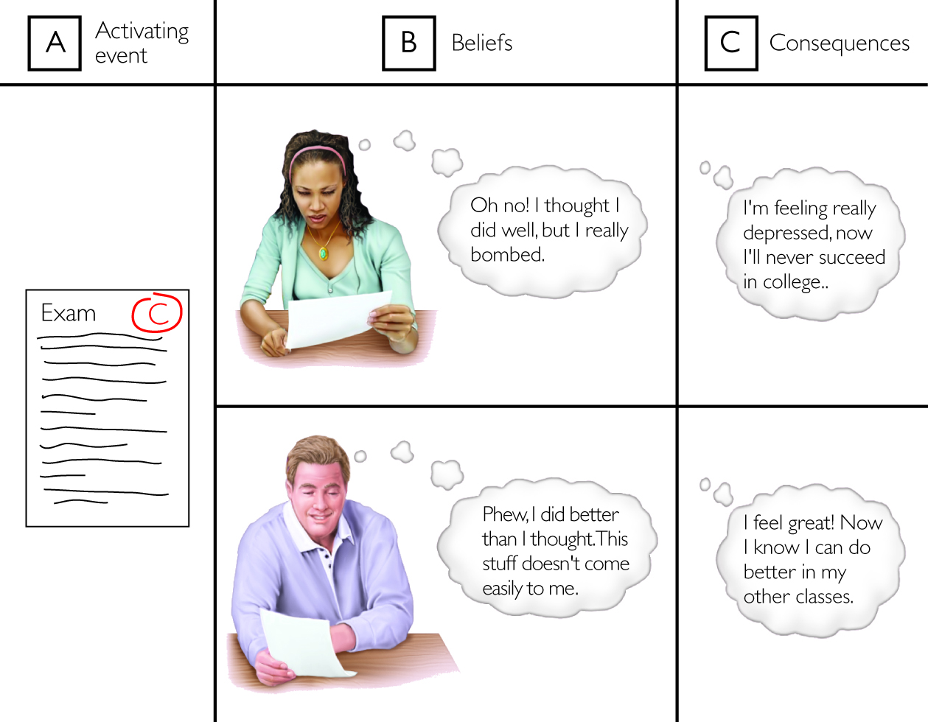
Figure 16.4 The ABCs of Rational Emotive Behavior Therapy

Slide 29
Cognitive-Behavioral and Third-Wave Therapies (3 of 6) LO 16.4b Describe the features of cognitive-behavioral therapies (CBT) and third wave therapies.
Rational emotive behavior therapy, continued
Our vulnerability to psychological disturbance is a product of the frequency and strength of our irrational beliefs.
To the ABC, Ellis added D (dispute the beliefs) and E (adopt more effective ones).
Notes:
LO 16.9

Slide 30
Cognitive-Behavioral and Third-Wave Therapies (4 of 6) LO 16.4b Describe the features of cognitive-behavioral therapies (CBT) and third wave therapies.
Other CBT approaches
Aaron Beck developed cognitive therapy around the same time as Ellis’s REBT.
Focuses on identifying and then modifying distorted thoughts and long-held core beliefs
Works very well for depression; some evidence of success with bipolar disorder and schizophrenia
Notes:
LO 16.9

Slide 31
Cognitive-Behavioral and Third-Wave Therapies (6 of 6) LO 16.4b Describe the features of cognitive-behavioral therapies (CBT) and third wave therapies.
CBT evaluated scientifically
More effective than no or placebo treatment
At least as or more effective than psychodynamic and humanistic therapies
At least as effective as drug therapies for depression
In general, CBT and BT are equally effective for most problems.
Notes:
LO 16.9

Slide 32
16.5: Is Psychotherapy Effective?
16.5a Evaluate the claim that all psychotherapies are equally effective.
16.5b Explain how ineffective therapies can sometimes appear to be effective.

Slide 33
The Dodo Bird Verdict (1 of 2) LO 16.5a Evaluate the claim that all psychotherapies are equally effective.
Prior to 1970s, considerable controversy
Meta-analysis studies showed that therapy does work in alleviating human suffering.
But which therapy? And for whom?
Notes:
LO 16.10

Slide 34
16.6: Biomedical Treatments: Medications, Electrical Stimulation, and Surgery
16.6a Recognize different types of drugs and cautions associated with drug treatment.
16.6b Outline key considerations in drug treatment.
16.6c Identify misconceptions about biomedical treatments.

Slide 35
Biomedical Treatments LO 16.6a Recognize different types of drugs and cautions associated with drug treatment.
Attempt to directly alter the brain’s chemistry or physiology to treat psychological disorders
Psychopharmacotherapy—use of medications—is the most widespread.
Began with use of Thorazine in 1954; today antidepressants are the most commonly prescribed medications among adults.
Notes:
LO 16.12

Slide 36
Psychopharmacotherapy (1 of 3) LO 16.6a Recognize different types of drugs and cautions associated with drug treatment.
Today, medications are available to treat most psychological disorders.
Antianxiety, antidepressants, mood stabilizers, antipsychotics, psychostimulants
Unfortunately, we don’t know exactly why most of these work.
Notes:
LO 16.12

Slide 37
Psychopharmacotherapy (2 of 3) LO 16.6a Recognize different types of drugs and cautions associated with drug treatment.
Cautions to consider
Not a cure-all, as most meds have numerous side effects that need to be weighed
Most side effects dissipate after discontinuing the drug, but not all (tardive dyskinesia).
Weight, age, and even racial differences often affect drug response.
Questions about efficacy and safety of SSRIs in children and adolescents
Overprescription is also a concern for many, especially of psychostimulants for ADHD.
Polypharmacy is prescribing many medications at the same time; it can be hazardous.
Notes:
LO 16.12

Slide 38
Psychopharmacotherapy (3 of 3) LO 16.6b Outline key considerations in drug treatment.
Evaluating psychopharmacotherapy
In many cases, therapy alone can produce as great or better benefits for many disorders.
Clear advantages to combining meds and therapy when
Symptoms interfere greatly with functioning.
Therapy alone hasn’t worked for a two-month period.
Notes:
LO 16.13

Slide 39
Electrical Stimulation (1 of 2) LO 16.6c Identify misconceptions about biomedical treatments.
Electroconvulsive therapy (ECT) involves brief electrical pulses to the brain to produce a seizure.
Used to treat severe problems (intractable depression, schizophrenia) as a last resort
6 to 10 treatments given three times a week
Notes:
LO 16.14

Slide 40
Electrical Stimulation (2 of 2) LO 16.6c Identify misconceptions about biomedical treatments.
Most who undergo ECT would do so again and report improvements.
Must weigh benefits against problems
Over 50 percent relapse in six months
Short-term confusion and clouded memory
Vagus nerve and transcranial magnetic stimulation are both FDA-approved for treatment-resistant depression.
No large-scale studies on effectiveness; side effects similar to or greater than ECT
Notes:
LO 16.14

Slide 41
Psychosurgery LO 16.6c Identify misconceptions about biomedical treatments.
Brain surgery to treat psychological disorders, like prefrontal lobotomies
Used today as an absolute last resort with a handful of conditions
Severe OCD, depression, bipolar disorders
Notes:
LO 16.14

